Slide 1

MovieLens Fusion
An Integrated Movie Analytics Pipeline
DATA SCIENCE (24AD3107) Project Review-1
DATE: 22-09-2026 TIME: (9:00) AM
 | Under the Guidance of Ms. B PRATHYUSHA Assistant Professor, Department of Computer Science and Engineering, KLH CSE Bowrampet Campus
Team Members 2420030001 - DIKSHA YADAV 2420030332 - K. BHAVANA 2420030430 - G. TEJASHREE 2420030471 - N. NIKITHA REDDY

Slide 2
Outline of Project Work
Focus
Introduction
Literature Survey
Challenges
Research Objectives
Conclusion & Future Work
References
Publications Details

Slide 3
Problem Statement
Movie datasets contain information from multiple sources such as movie details, user ratings, genres, tags and external movie identifiers. However, these data sources may have different schemas, formats, missing values, duplicate records and inconsistent identifiers.
This makes it difficult to directly combine and analyze the data efficiently.
Therefore, there is a need for a structured data integration pipeline that can:
Clean and validate raw movie data
Standardize different data formats and schemas
Identify and remove duplicate records
Integrate multiple movie-related sources
Store the unified dataset in a structured database
Generate meaningful analytics and visualizations
Project Focus
“Transforming heterogeneous movie data into a clean, integrated and analysis-ready dataset.”
Visual:
Multiple Data Sources → Cleaning → Validation → Mapping → Deduplication → Integration → MySQL → Dashboard

Slide 4
Objectives
1. Data Collection
Obtain MovieLens movie, rating, genre and tag data.
Incorporate relevant external movie metadata where required.
2. Data Cleaning
Handle missing and inconsistent values.
Remove invalid or redundant records.
3. Schema Mapping
Map attributes from different sources into a common structure.
Standardize column names, formats and data types.
4. Data Deduplication
Identify duplicate movies and repeated records.
Maintain a consistent unique movie identity.
5. Data Integration
Combine cleaned datasets into a unified movie database.
6. Data Storage
Store the integrated data using MySQL.
7. Data Analysis & Visualization
Perform analytical queries.
Create meaningful visualizations using Matplotlib / Plotly / Power BI.

Slide 5
Literature Survey
Authors | Title of the Paper | Methodology | Inferences | Limitation / Future Work
Peralta [1] | Extraction and Integration of MovieLens and IMDb Data, Technical Report, 2007 | • Extracted MovieLens and IMDb data• Performed data cleaning and transformation• Matched movie titles across datasets• Constructed an integrated database | • Demonstrates a complete MovieLens–IMDb integration process• Shows the importance of schema transformation and entity matching• Only 79% of movie-title matches were identical, requiring additional matching strategies | • Title matching was challenging• Manual lookup was required for some records• Future work can improve automated entity matching and integration accuracy
Harper & Konstan [2] | The MovieLens Datasets: History and Context, ACM TiiS, 2015 | • Examined MovieLens dataset development and characteristics• Analyzed dataset usage and limitations• Provided guidelines for using MovieLens in research | • Establishes MovieLens as a widely used research dataset• Provides understanding of ratings, dataset structure and appropriate usage• Highlights limitations that researchers should consider | • Focuses primarily on dataset history, characteristics and usage rather than building a complete data-integration pipeline• Further integration with heterogeneous external sources can be explored
Pérez et al. [3] | Improving Movie Recommendation Systems Filtering by Exploiting User-Based Reviews and Movie Synopses, 2020 | • Used MovieLens rating data• Linked MovieLens identifiers with IMDb/TMDB content• Combined movie plots with ratings• Applied text preprocessing using NLTK | • Demonstrates enrichment of MovieLens with external movie information• Shows the usefulness of linking multiple movie-data sources• Required preprocessing before combining the datasets | • Primarily focuses on recommendation performance rather than data integration itself• External metadata can introduce missing or inconsistent records requiring additional validation
Peralta [4] | Extraction and Integration of MovieLens and IMDb Data — Integrated Database Approach | • Defined source and target schemas• Extracted and transformed heterogeneous movie data• Applied movie-entity matching• Stored results in a relational database | • Shows that MovieLens and IMDb can be transformed into a common schema• Demonstrates database construction after integration• Provides a direct precedent for a MovieLens data-integration pipeline | • Matching based heavily on movie titles creates ambiguity• More robust identifier-based and automated matching can improve integration

Slide 6
Problem Gap Identification
Existing MovieLens-based studies primarily focus on:
Recommendation algorithms
Collaborative filtering
User-item rating prediction
Evaluation of recommender systems
Analysis of user preferences
However, the data preparation and integration problem itself is often treated as a preprocessing step rather than the central objective.
Identified Gap
There is a need for a systematic pipeline that focuses on:
Heterogeneous Data → Standardization → Validation → Deduplication → Integration → Analysis
Our Project Addresses This Gap By
Treating data integration as the core problem
Combining movie-related datasets under a common schema
Applying systematic cleaning and validation
Resolving duplicate movie identities
Creating a reusable integrated database
Making the resulting dataset directly usable for analytics
MovieLens itself provides multiple related datasets and identifiers, including links to external entities in some releases, which makes it suitable for demonstrating integration challenges.

Slide 7
Innovation, Creativity, and Novelty
Innovation
Uses a structured multi-stage pipeline instead of performing isolated preprocessing.
Integrates multiple movie-related datasets into a common representation.
Connects data engineering with analytical visualization.
Creativity
Movie-focused data fusion workflow
Interactive analytical dashboards
Clear before/after view of data quality
Visual representation of the transformation from raw → integrated data
Novelty
The project emphasizes the complete journey of movie data rather than only the final analysis.
Raw heterogeneous data → Quality improvement → Integration → Database → Analytics

Slide 8
Feasibility and Project Plan
Factor | Feasibility
Data Availability | MovieLens provides publicly available datasets suitable for research and education
Technology | Python, Pandas, MySQL and visualization tools are sufficient
Computational Requirement | Pipeline can be developed and tested using standard computing resources
Implementation | Modular stages allow individual components to be developed and tested separately
Scalability | Pipeline can be extended to larger MovieLens datasets
Cost | Uses freely available datasets and open-source development tools

Slide 9
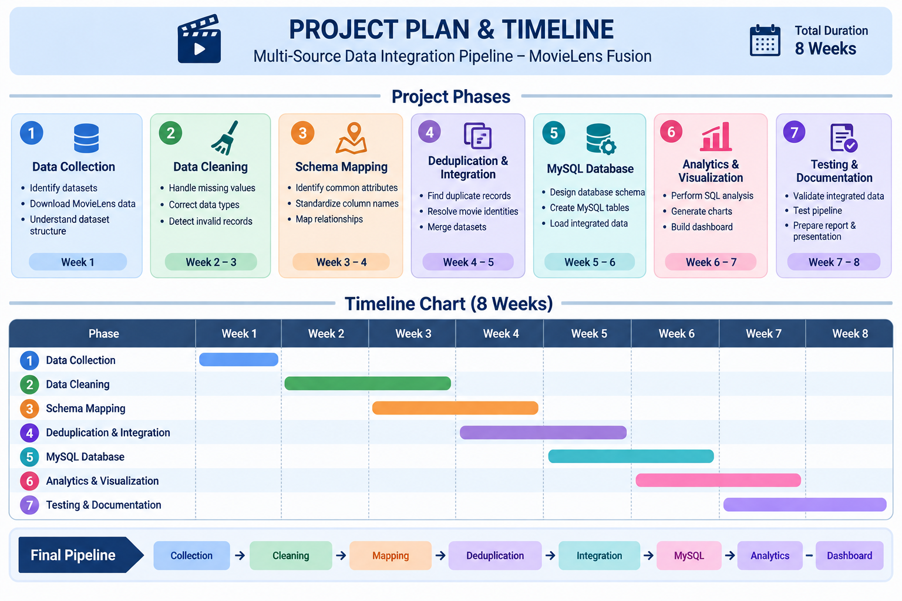

Slide 10
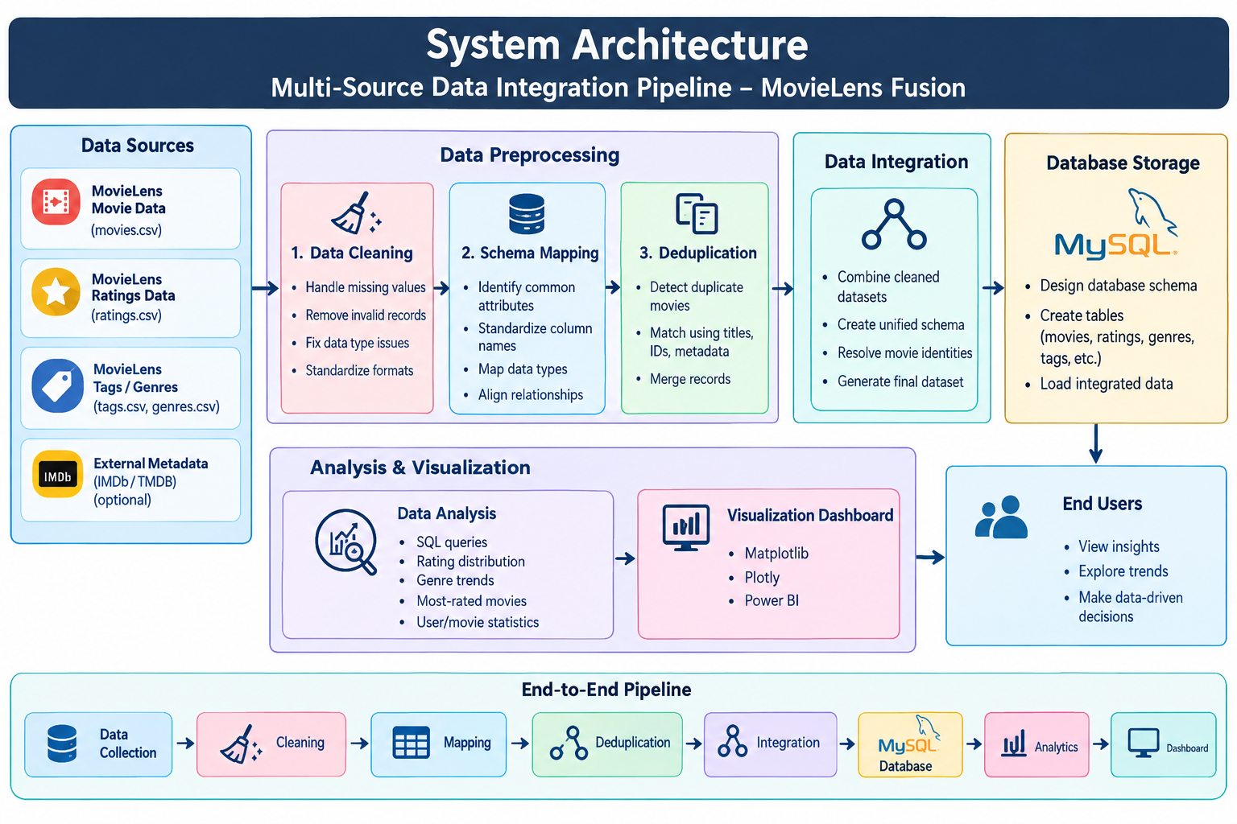

Slide 11
THANK YOU

